Slide 1
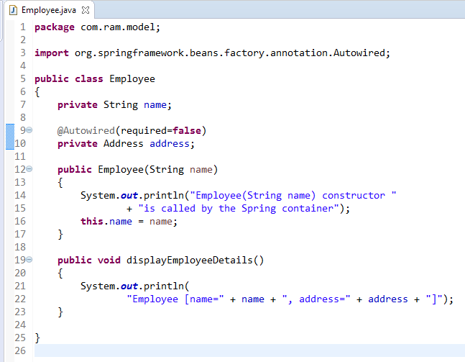
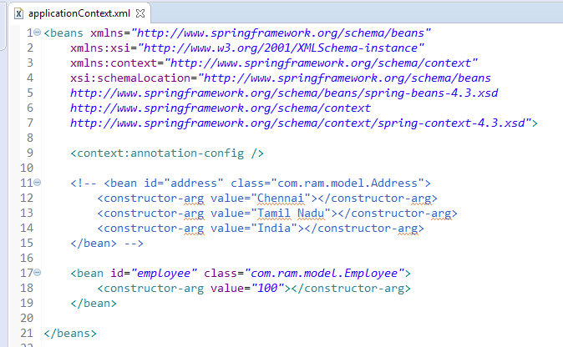
Dependency checking
By default, the @Autowired will perform the dependency checking to make sure the property has been wired properly.
When Spring can’t find a matching bean to wire, it will throw an exception.
To fix it, you can disable this checking feature by setting the “required” attribute of @Autowired to false.

Slide 2
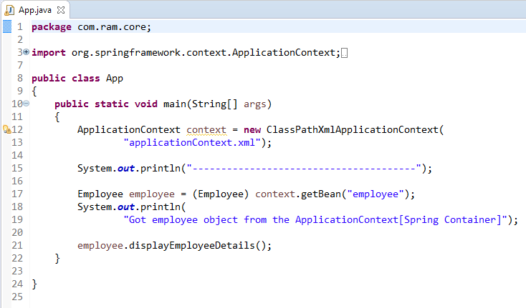
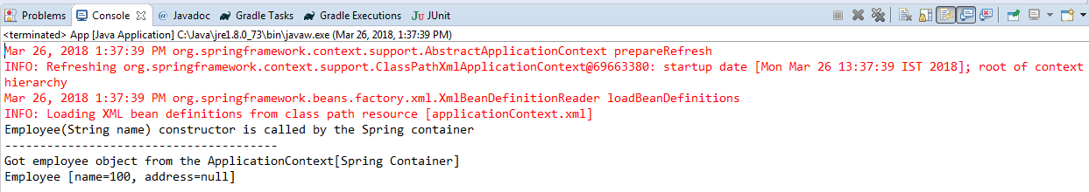
Dependency checking

